Slide 1
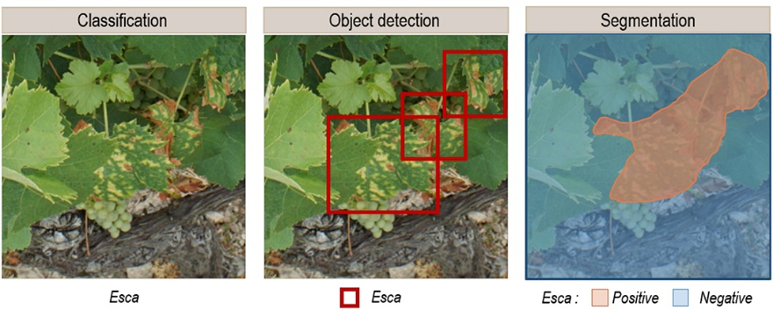
Multi-Crop AI
Multi-Crop AI is an AI-driven platform using CNN-based image analysis to deliver rapid diagnostics across major crops, classifying over 140+ classes of diseases and healthy conditions.
It enables data-driven, targeted interventions and scalable mobile deployment for on-field use, reducing unnecessary chemical application and improving timely decision-making for farmers.

Slide 2

Title & Authors
Plant Disease Detection Using Machine Learning
Students: Paras Dupar (72413867) and Jaskaran Singh (72412122).
Course: Data Science.
Submit To: Mr. Lokesh Sir
Institution: [CT UNIVERSITY]
This project develops an image‑based ML pipeline to classify common crop diseases, emphasizing accuracy, robustness, and potential for mobile deployment to support on‑field decision making.

Slide 3

01
Project Overview.

Slide 4

Agriculture underpins food security and rural livelihoods; crop diseases cause significant yield loss and economic strain for farmers. Effective monitoring is essential to maintain productivity and sustainability.
Automated image‑based detection enables early intervention, scalable surveillance, and data-driven prioritization of treatments, reducing losses and improving resource allocation.

Slide 5
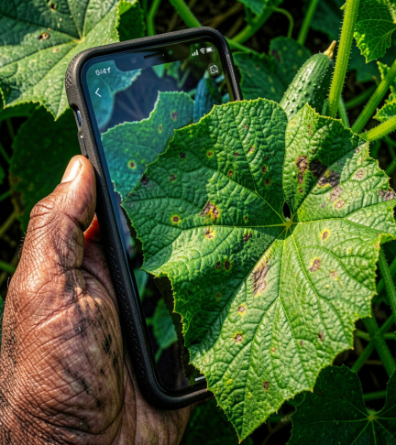
CNN-based detection
Our CNN model classifies 140+ disease classes across major crops using leaf imagery and preprocessing pipelines.
Optimized for low-latency inference to support near real-time diagnostics on edge and mobile devices.

Slide 6

02
Data & Methods

Slide 7
Dataset Description
Extensive labeled image repository covering multiple crops and diseases (apple scab, tomato blight, wheat rust, cotton pests), collected from field captures and curated sources. Images vary in resolution, lighting, and growth stages to enhance model generalization.
Dataset includes metadata (location, timestamp), class counts and annotation quality audits. Targeted sampling and augmentation mitigate imbalance and ensure diverse species representation for robust training.

Slide 8

Model Architecture
A CNN backbone with transfer learning (pre-trained encoder) followed by custom classification head.
Convolutional blocks extract features; global pooling and dense layers produce final class probabilities. Early stopping and regularization used to prevent overfitting.

Slide 9
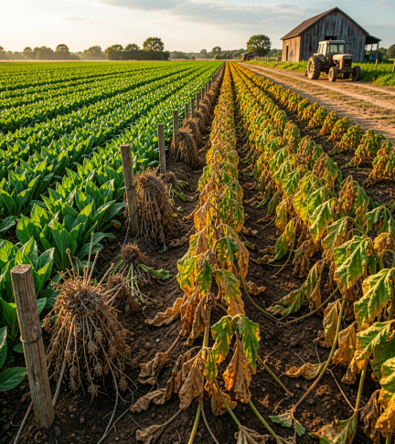
01
Problem & Impact

Slide 10
Manual diagnosis limits
Traditional diagnosis is time-consuming, expensive, and depends on scarce specialists, causing delayed treatment and inconsistent outcomes in rural areas. Human assessment also introduces variability and misclassification risks.
Our platform enables scalability through mobile and edge deployment with real-time inference and offline support, democratizing expert diagnostics, reducing unnecessary chemical applications, and lowering costs for smallholder farmers.

Slide 11
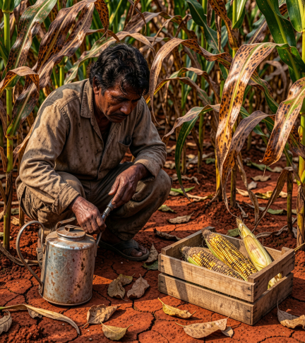
Economic losses for farmers
Crop diseases cause significant yield reductions and income loss for smallholders, increasing risk of food insecurity.
Treatment delays and blanket spraying inflate input costs and reduce profit margins. Early, accurate diagnosis can cut avoidable expenses and stabilize farmer livelihoods.

Slide 12
Real-world benefits
Early detection enables proactive management, containing infections before they escalate and significantly reducing yield loss and downstream supply disruptions.
Precise disease identification supports specific treatments, cutting blanket pesticide use, lowering input costs, and advancing sustainable, environmentally responsible farming practices while improving long-term soil and ecosystem health.

Slide 13
Future integrations
Field-ready mobile app deployment paired with weather-data fusion enhances predictive risk scoring and localized advisories, enabling proactive scheduling of inspections and interventions.
Edge inference with offline capabilities plus cloud sync ensures scalable, low-latency diagnostics, centralized analytics, and API integration for farm advisory platforms, supporting large-scale pilots and continuous model improvement.

Slide 14
Conclusions
The AI system provides rapid, high-accuracy multi-crop disease diagnosis, enhancing agronomic decision-making, reducing input costs, and lowering crop loss risks.
Planned next steps: pilot field deployment with performance validation, farmer training programs, integration with weather and advisory platforms, and iterative model improvement via centralized analytics to ensure scalability and measurable impact.

